Slide 1

Bangladesh University of Engineering and Technology
ME 174(CSE):
MECHANICAL ENGINEERING DRAWING
Course Teachers:
Shahriar Alam, Assistant Professor
Taslima Hossain Sanjana, Adj. Lecturer
Department of Mechanical Engineering, BUET

Slide 2
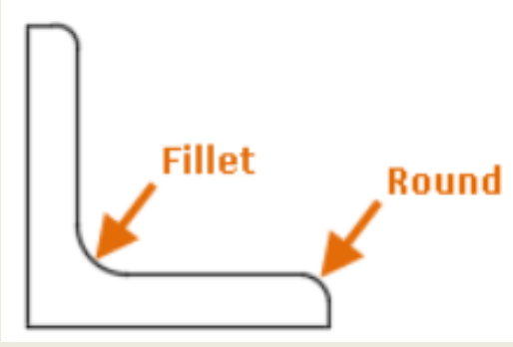
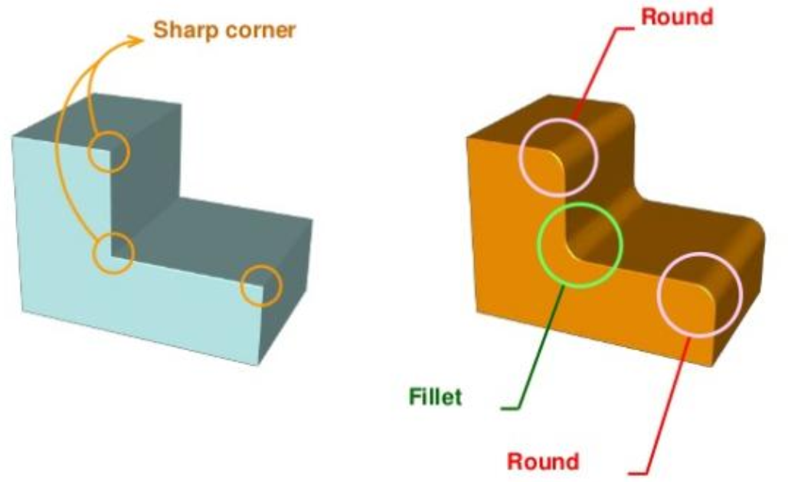
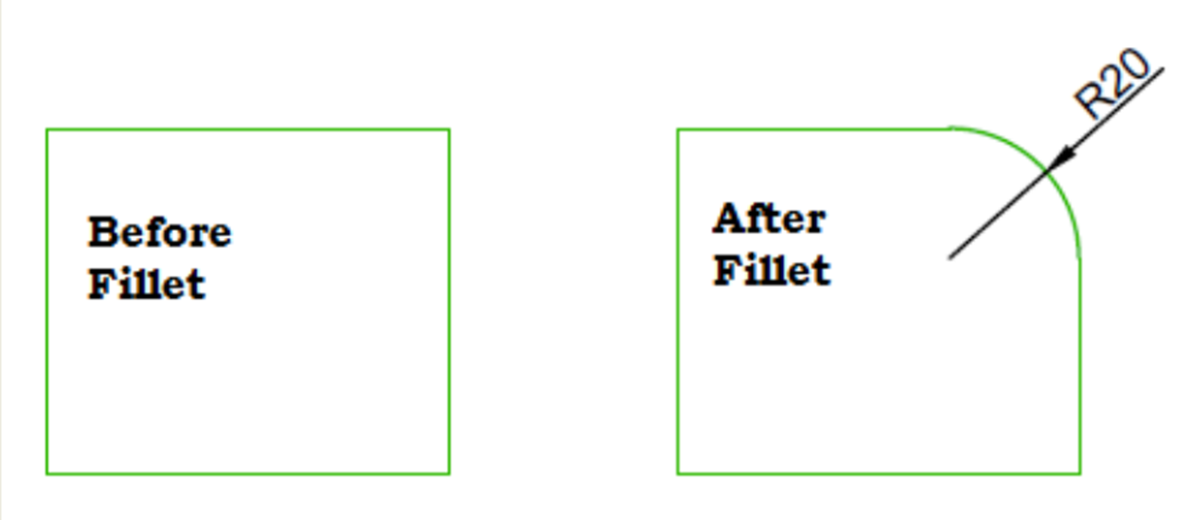
Rounds and Fillets: Definition & Purpose
• A fillet or round connects two objects with a tangent arc in 2D
• An inside corner is called a fillet, and an outside corner is called a round
• The sharp internal corners are made rounded to avoid the possibility of stress cracking
• The sharp external corners are made rounded for safety and appearance

Slide 3

THANK YOU

